Slide 1
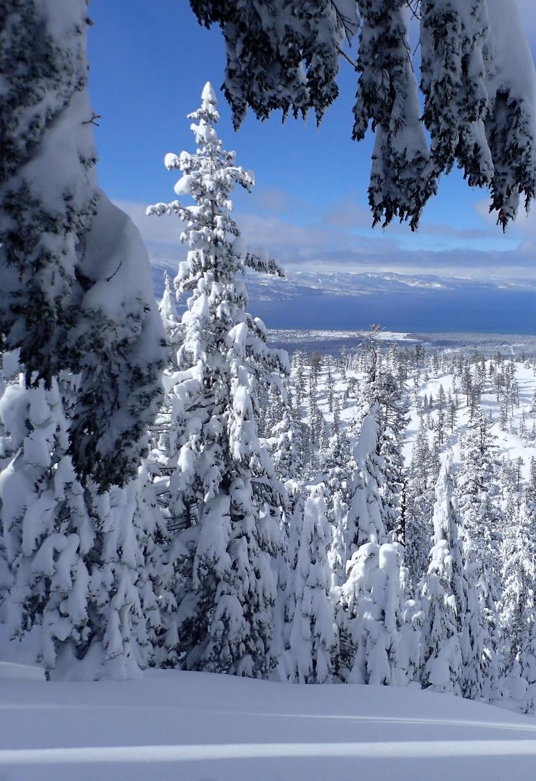
Tahoe Science Advisory Council Program Assessment
Robert Larsen

Slide 2
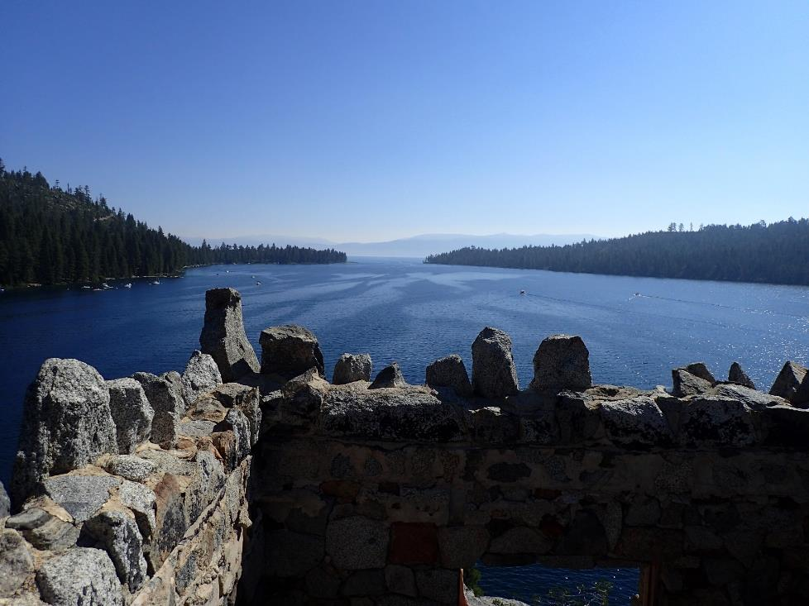
Council Progress
Successes
Peer Review
Science to Action Planning
Challenges
Project coordination and
implementation

Slide 3
Science/Management Best Practices
1. Program Purpose
2. Diversity
3. Transparency and Objectivity

Slide 4
Program Purpose
“...seek the use of the best available science to support restoration and conservation management decisions…”

Slide 5
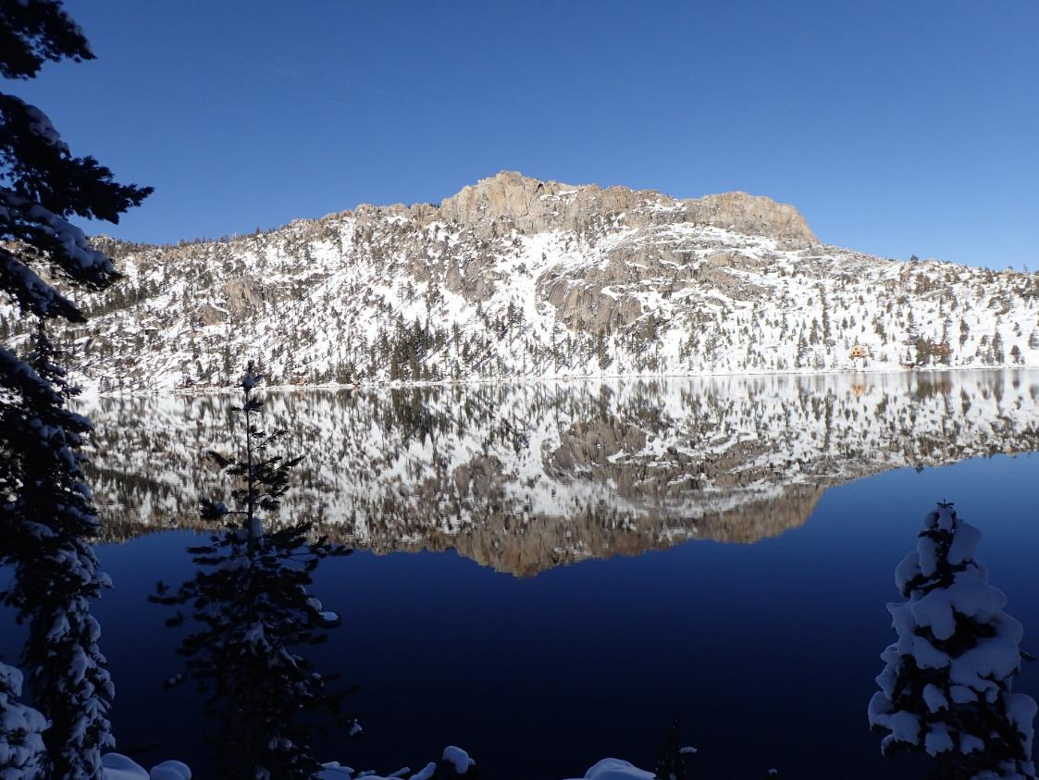
Diversity
Expertise
Perspective
Career Stage
Gender
Ethnicity

Slide 6
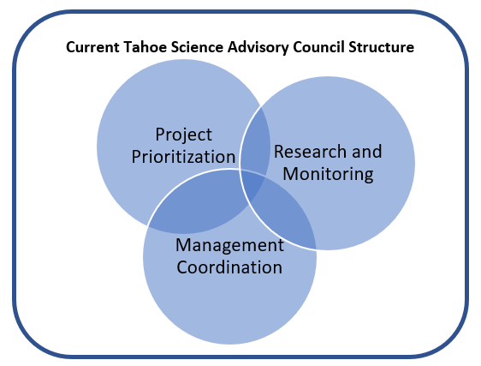
Transparency and Objectivity

Slide 7
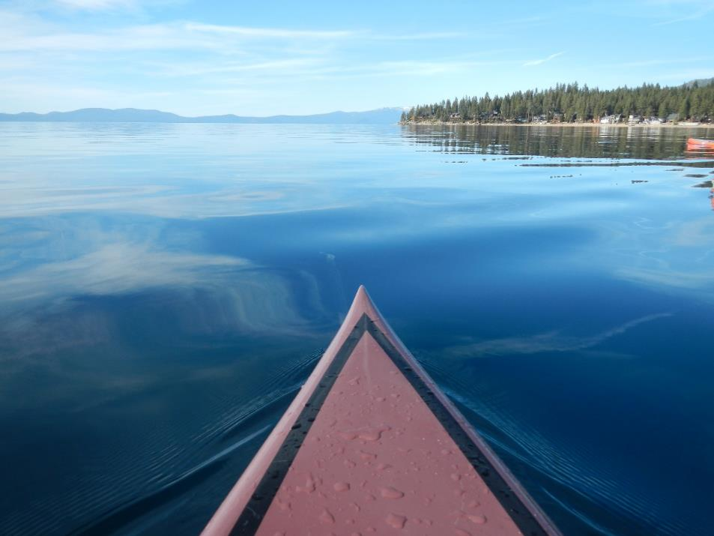
Opportunities
Renew focus on the science/management partnership
Explore ways to increase Council diversity
Refine processes to separate advisory and project functions

Slide 9
Tahoe Science Advisory Council Structure recommendations
Robert Larsen

Slide 10
Science/Management Best Practices
1. Program Purpose
2. Diversity
3. Transparency and
Objectivity

Slide 11
Council Membership
Current
Strong natural science emphasis
Driven by in-basin perspectives
Little change since Council inception
Potential enhancements
Social science knowledge
Transportation expertise
Management coordination experience

Slide 12
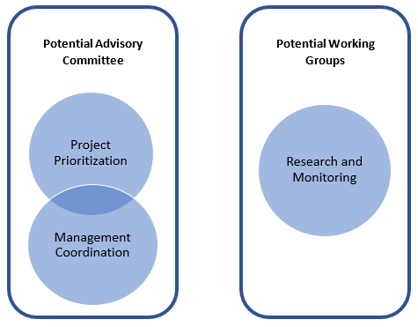
Council Organization

Slide 13
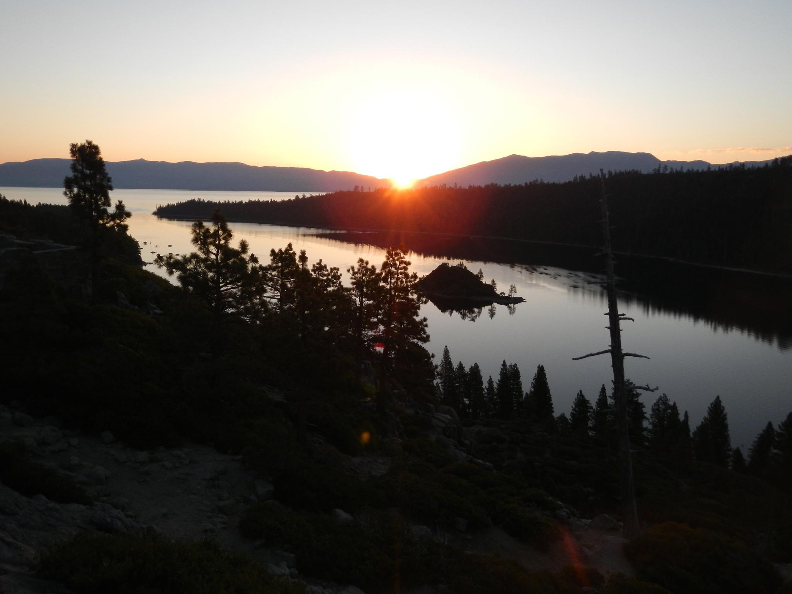
Council Advisory Committee
Facilitate partner coordination
Support RFP development and review
Enhance objectivity

Slide 14
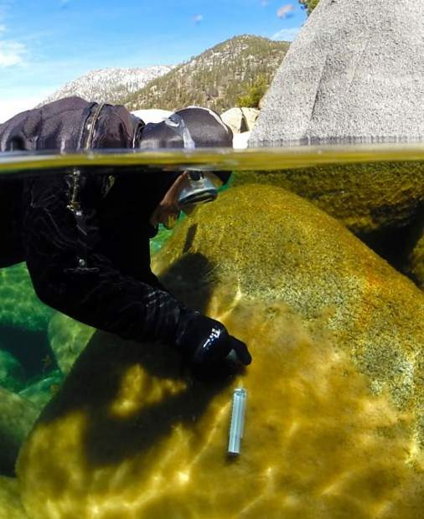
Council Working Groups
Provide technical guidance
Maintain connection to new and ongoing projects
Leverage institutional expertise
Brant Allen / UC Davis TERC

Slide 15
Next Steps
Engage with the Council
Meet with institutions
Implement new ideas

