Slide 1

Science-to-Action Timeline
Tahoe
Science to Action
LT Seasonal Clarity Assessment
2019
Upland Ecosystem Science to Action
Clarity Model Review
2020
Science-to-Action Workshops
Science-to-Action Priorities
LT Data Synthesis and Analysis
2021

Slide 2
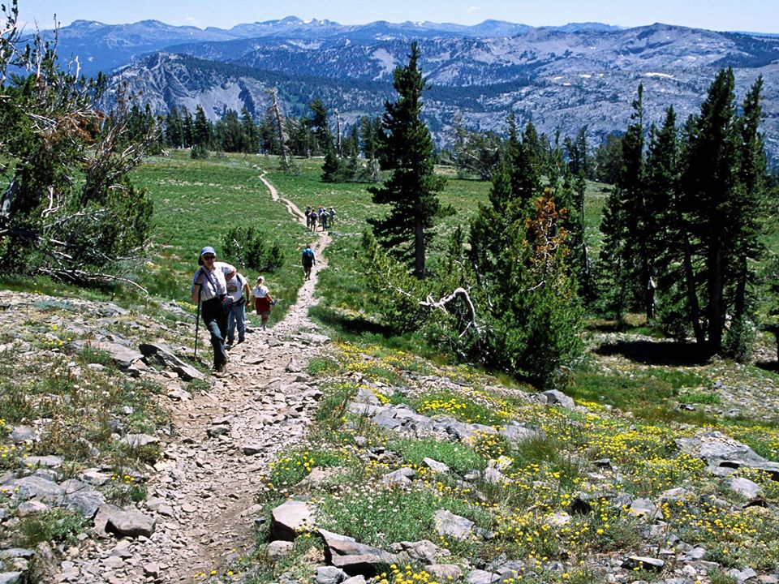
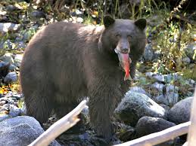
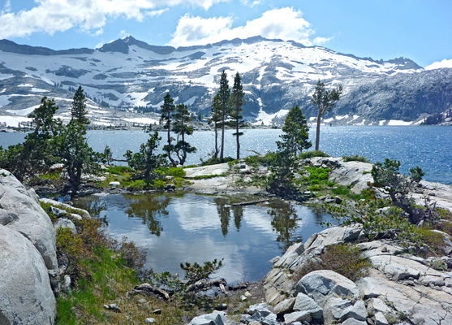
Integrated Research to Support Restoration of Upland Ecosystems
in the Lake Tahoe Basin
Tahoe Science Advisory Council
Executive Meeting
March 23, 2021
TSAC Upland Ecosystem Team
Pat Manley, USFS Pacific Southwest Research Station
Adrian Harpold, University of Nevada, Reno
Sudeep Chandra, University of Nevada, Reno
Max Moritz, University of California, Santa Barbara
Adam Watts, Desert Research Institute

Slide 3
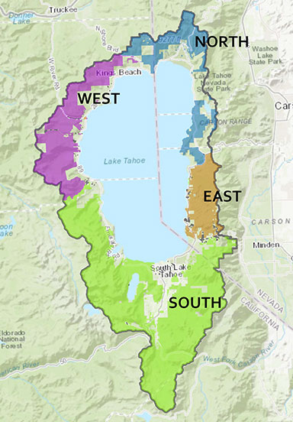
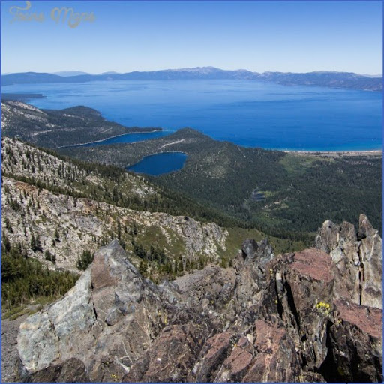

Slide 4
Focal Areas of the Upland Ecosystem Science-to-Action Plan
Notes:
Focus on filling key information gaps to reduce risk and uncertainty
Focus on developing tools and techniques to help managers implement restoration
Inclusive of the full suite of interconnected upland ecosystems
Focus on….
Understanding how climate and human inputs can and will affect desired outcomes
Monitoring system design to meet ongoing info needs
Strong management, stakeholder, and partner engagement

Slide 5
Focal Areas of the Upland Ecosystem Science-to-Action Plan
Tree stress and mortality
Restore fire dynamics
Carbon sequestration
Notes:
It will not cover social and economic research needs – suggest that these are also pursued this year as another topic area
Inclusive of the full suite of interconnected upland ecosystems
Focus on….
Understanding how climate and human inputs can and will affect desired outcomes
Monitoring system design to meet ongoing info needs
Strong management, stakeholder, and partner engagement

Slide 6
Focal Areas of the Upland Ecosystem Science-to-Action Plan
Habitat dynamics
Climate tolerances
Forest functions
Reforestation
Notes:
It will not cover social and economic research needs – suggest that these are also pursued this year as another topic area
Inclusive of the full suite of interconnected upland ecosystems
Focus on….
Understanding how climate and human inputs can and will affect desired outcomes
Monitoring system design to meet ongoing info needs
Strong management, stakeholder, and partner engagement

Slide 7
Focal Areas of the Upland Ecosystem Science-to-Action Plan
Habitat dynamics
Water dynamics
Climate tolerances
Invasive species
Wetland integrity & function
Notes:
It will not cover social and economic research needs – suggest that these are also pursued this year as another topic area
Inclusive of the full suite of interconnected upland ecosystems
Focus on….
Understanding how climate and human inputs can and will affect desired outcomes
Monitoring system design to meet ongoing info needs
Strong management, stakeholder, and partner engagement

Slide 8
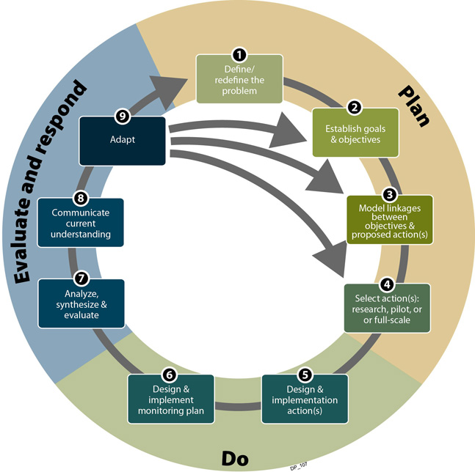
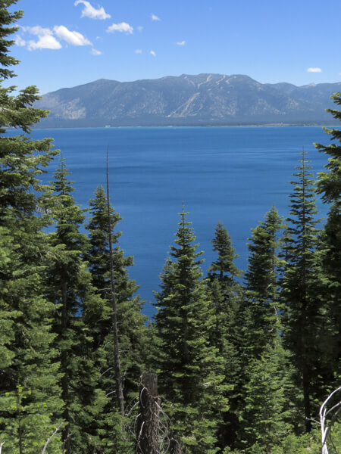
The Essential Role of Research in Restoration
Adaptive Management Cycle - CDFW
Problem definition
FOR BEST PERFORMANCE,
INSERT RESEARCH HERE
Adapt
Goals & objectives
Communi-cate
Model linkages
Evaluate
Validation
Monitor
Implement
Notes:
Research is an important part of successful restoration – understanding the factors that drive and threaten desired outcomes and how to best design and implement management interventions to have the desired effect
The Southern Nevada Public Lands Management Act was a primary funder of research in the basin, and over $25 million has been devoted to research from this source alone
Funding for environmental research in the basin as part of the Lake Tahoe Restoration Act over the past 25 years has approached $30 million, with roughly 25% of those investments directed at upland ecosystem restoration research (Knopp et al. 2016)
Given the highly interdependent nature of the basin’s ecosystems, and the formidable challenges that climate change poses to all ecosystems in the Lake Tahoe basin, it has become clear that we must take an integrated, systems-approach to research and management across the basin
Toward this goal, we developed the Upland Ecosystem Science to Action Plan as a companion to the Lake Tahoe Science to Action Plan, and together they represent a highly integrated ridge to lake, or as they say in Hawaii Mauka to makai, systems-approach to supporting restoration and resilience objectives across the basin

Slide 9
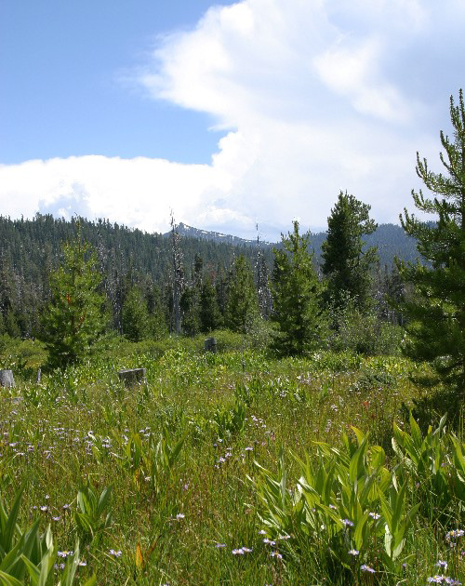
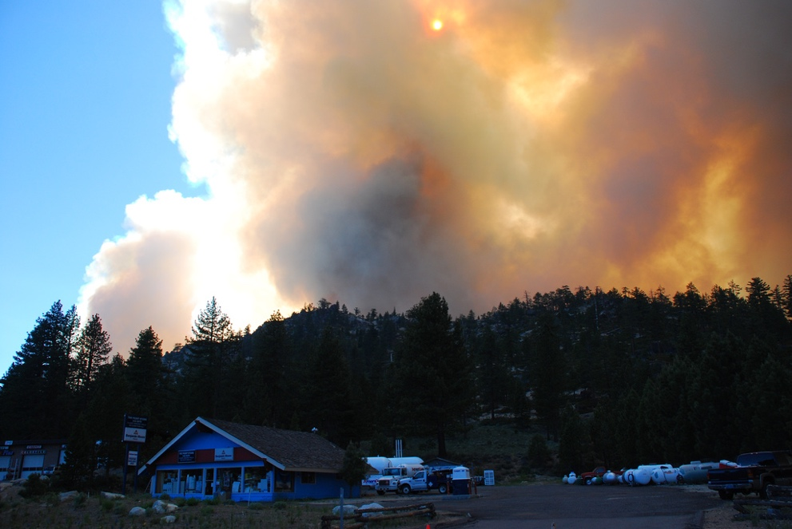

Near-term Upland Plan Implementation Activities:
Tasks 1 & 2
  Hold science-management exchange workshops with managers, stakeholders and partners
    Identify priority information, tools, methods
    Identify adaptive management opportunities
    Refine monitoring needs and introduce new approaches
  Develop proposals, seek funding, grow research capacity, and accomplish Task 1 priorities
  Consolidate input into a 10-year research plan

Slide 10
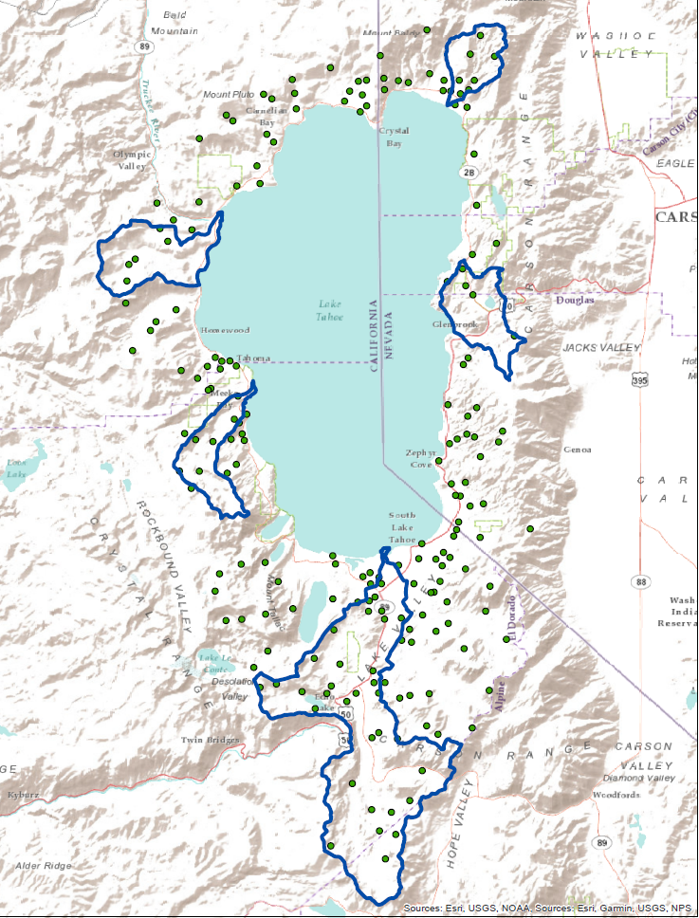
Tahoe Ecological Observatory Network:
Sentinels for the Environmental Integrity of Lake Tahoe’s Uplands
Establish “sentinel watersheds”
  Backbone for upland ecosystem monitoring & research strategy
  Ward, Meeks, Incline, Glenbrook, Slaughterhouse, Upper Truckee
Invest in automated data collection - “smart watersheds”
  Biophysical conditions
    Water quality, hydrologic dynamics, biodiversity, forest health, aquatic habitat, valued tribal resources
  Climate
    Temperature, precipitation, snow dynamics
Engage with the manager, stakeholder and Tribal communities
  What are we learning?
  How can we improve?
Leverage to accomplish basin-wide monitoring strategy
Notes:
through access to real-time data streams, field trips, webinars, and interactive, augmented reality apps along access routes – maybe adopt a smart watershed

Slide 11
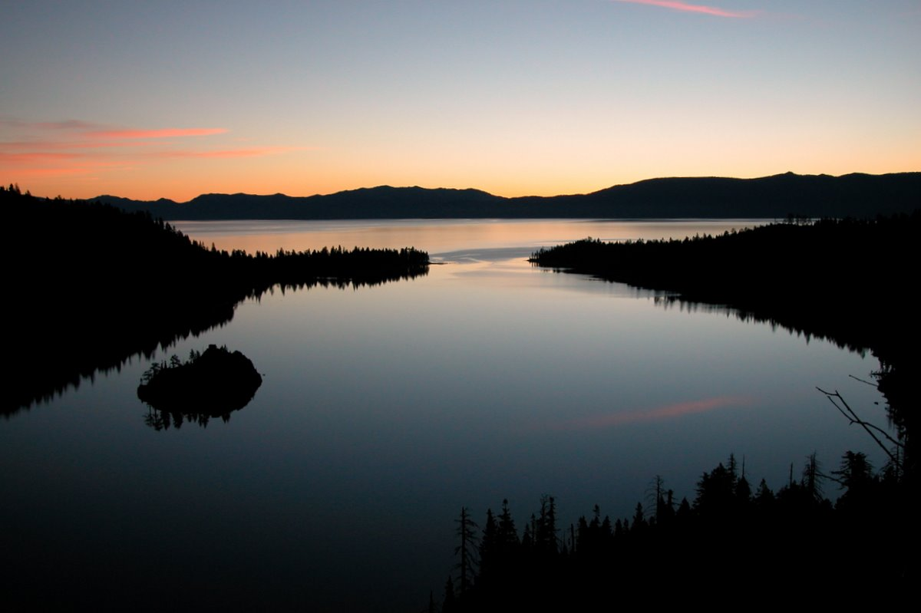
Lake tahoe science-to-action plan update
Dr. Sudeep Chandra
University of Nevada, Reno’s Global Water Center
Lake Tahoe Science to Action Team
Alan Heyvaert, Desert Research Institute
Geoff Schladow, University of California, Davis
Ramon Naranjo, United States Geological Survey
John Melack, University of California, Santa Barbara

Slide 12

Clarity Model Review
The 2001 model was state of the art
  1-dimensional
  Nested sub-models
  Driven by external inputs

Slide 13
Clarity Model Review
Council members evaluated strengths and weaknesses
  Summarized available data
Recommendations:
  Reevaluate simplifying assumptions
  Consider a 3D structure
  Enhance ecological algorithms

Slide 14
Lake Tahoe Data Synthesis and Analysis
Compile an integrated review and analyses of relevant water quality data
Support an annual executive-level briefing on watershed and lake conditions.
Improve collaboration and coordination among agency partners and the Council
Develop collaborative recommendations for data collection programs, analyses, modeling integration and reporting

Slide 15
Lake Tahoe Data Synthesis and Analysis
Phase 1 - planning project and approaches (complete)
Phase 2 (through August 2021) - implement the process
  Evaluate 2020 data
  Facilitate discussion between partners
Phase 3 - Continue annual iteration of the process
  Consider new approaches to data analysis
  Assess linkages to other relevant projects

Slide 16
Moving toward the future
May-June 2021 – DSA Workshop with partners
June-July 2021 - Executive briefing on lake conditions
Develop proposals to revisit the lake clarity model (in progress)
Reintegrate our understanding of nearshore processes (needs council discussion)

Slide 17
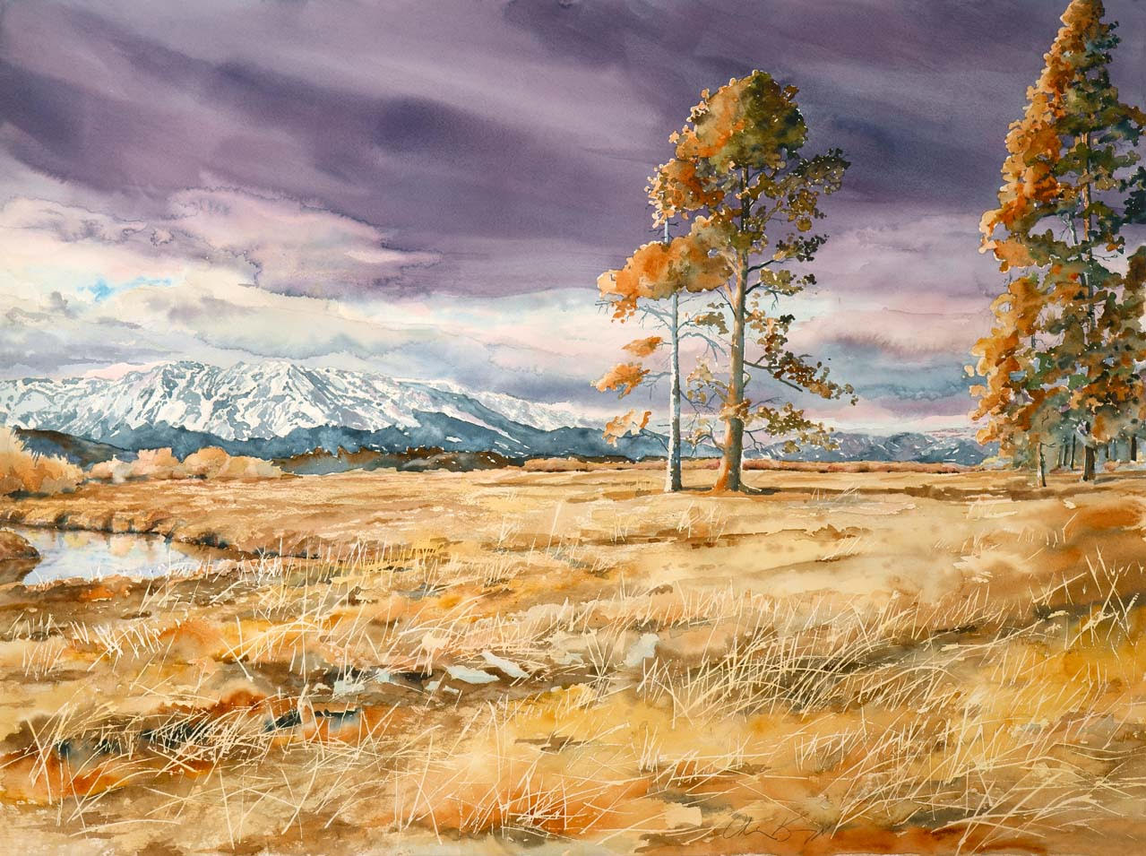
Chris Knopp

